Slide 1
Sampling and
Sampling Distributions

Slide 2
Statistics
Descriptive statistics
Collecting, presenting, and describing data
Inferential statistics
Drawing conclusions and/or making decisions concerning a population based only on sample data

Slide 3
Populations and Samples
A Population is the set of all items or individuals of interest
Examples: All likely voters in the next election
All parts produced today
All sales receipts for November
A Sample is a subset of the population
Examples: 1000 voters selected at random for interview
A few parts selected for destructive testing
Random receipts selected for audit

Slide 4
Why Sample?
Less time consuming than a census
Less costly to administer than a census
It is possible to obtain statistical results of a sufficiently high precision based on samples.

Slide 5
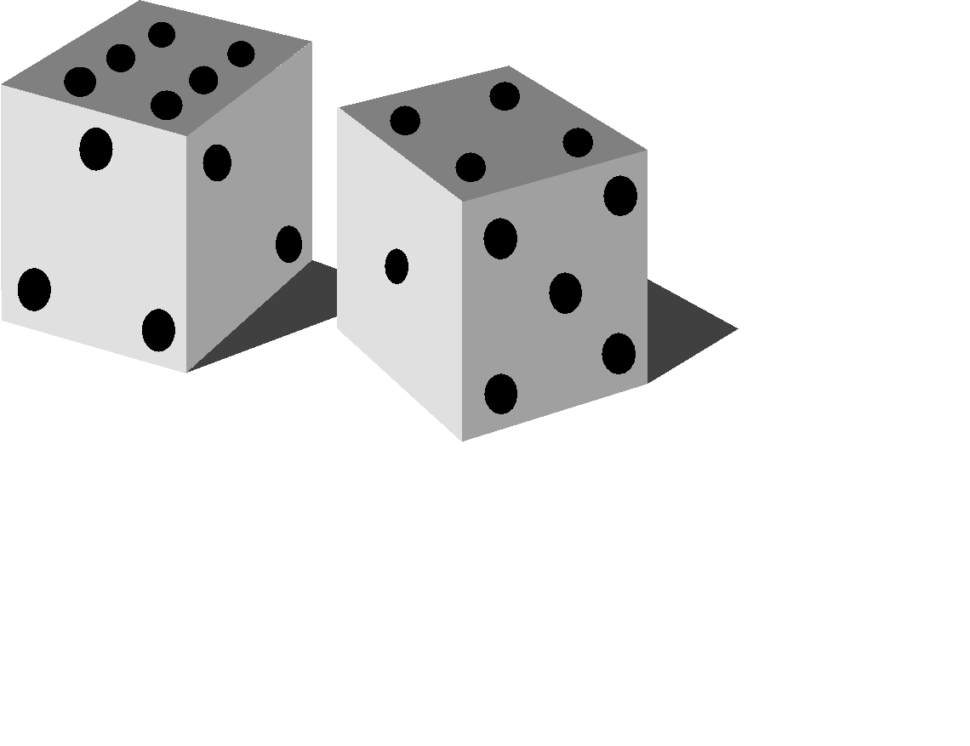
Simple Random Samples
Every object in the population has an equal chance of being selected
Objects are selected independently
Samples can be obtained from a table of random numbers or computer random number generators
A simple random sample is the ideal against which other sample methods are compared

Slide 6
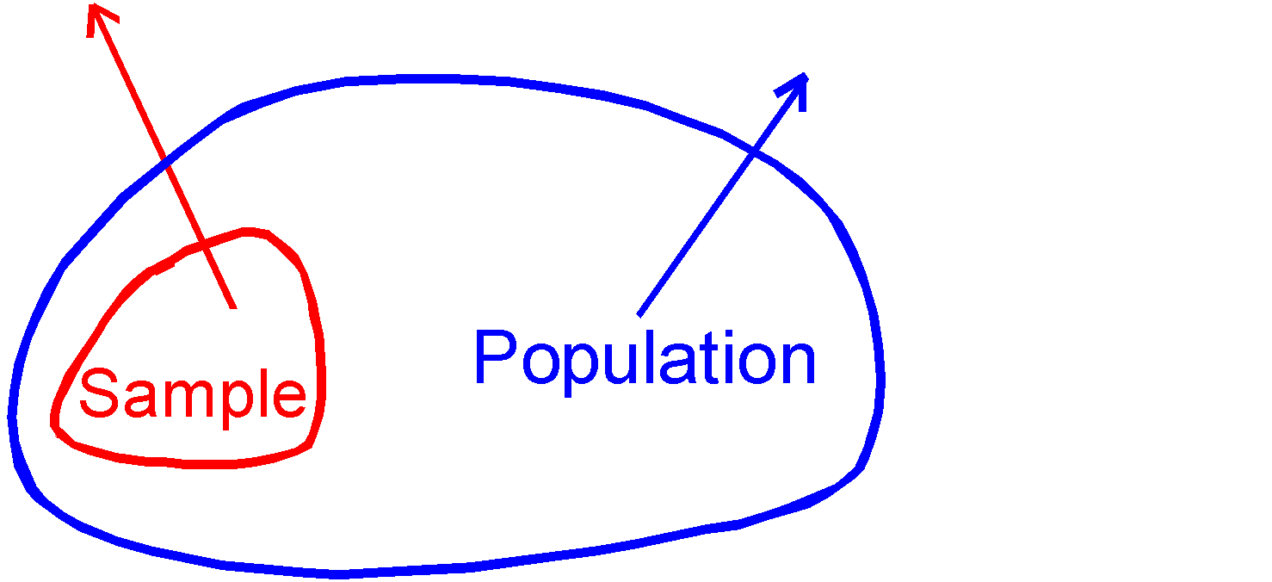
Inferential Statistics
Making statements about a population by examining sample results
Sample statistics Population parameters
(known) Inference (unknown, but can
be estimated from
sample evidence)

Slide 7
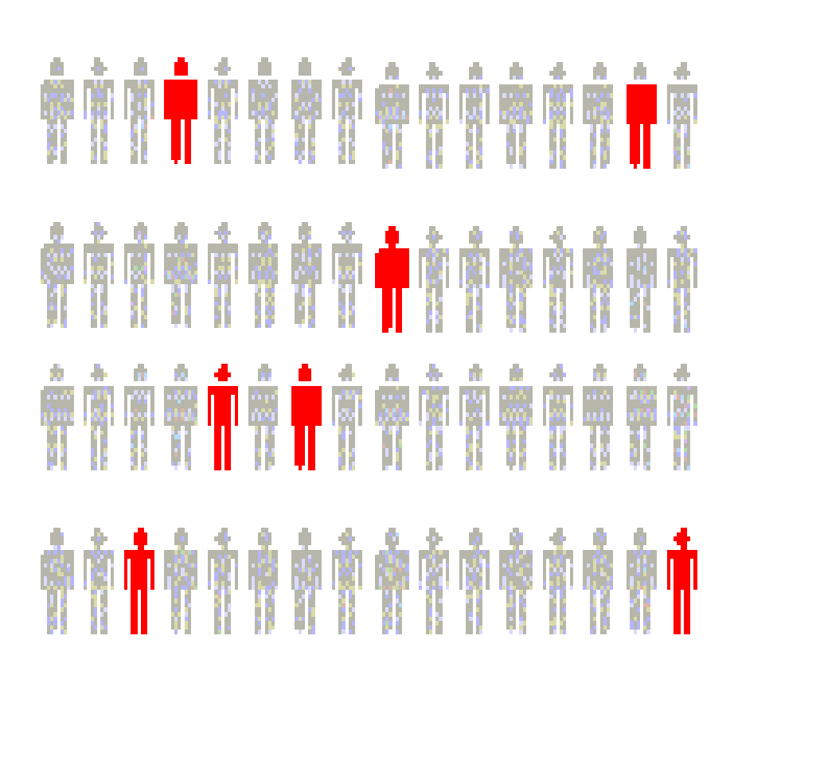
Inferential Statistics
Drawing conclusions and/or making decisions concerning a population based on sample results.
Estimation
e.g., Estimate the population mean weight using the sample mean weight
Hypothesis Testing
e.g., Use sample evidence to test the claim that the population mean weight is 120 pounds

Slide 8
Sampling Distributions
A sampling distribution is a distribution of all of the possible values of a statistic for a given size sample selected from a population

Slide 9
Sampling Distributions
Sampling Distribution of Sample
Mean
Sampling Distribution of Sample Proportion

Slide 10



Developing a Sampling Distribution
Assume there is a population …
Population size N=4
Random variable, X, is age of individuals
Values of X:
18, 20, 22, 24 (years)
D
A
B
C

Slide 11
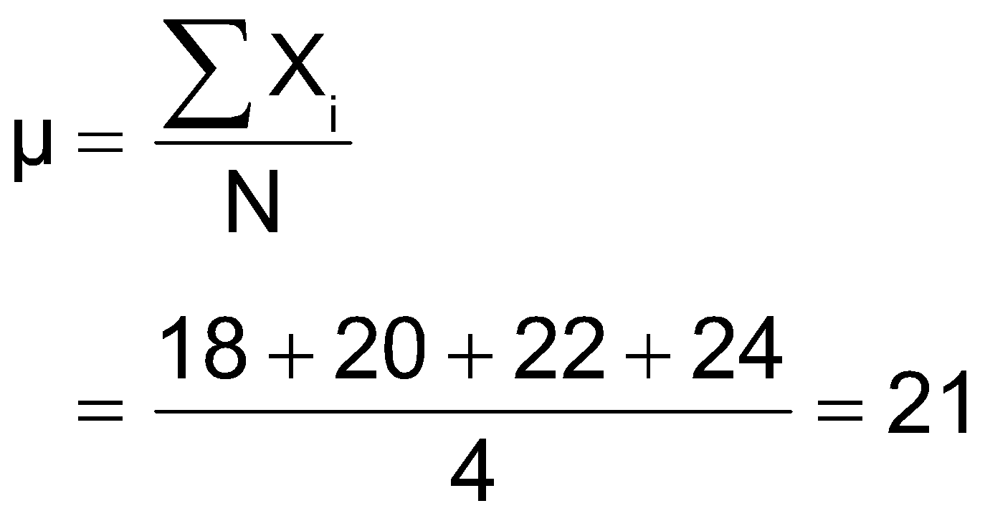
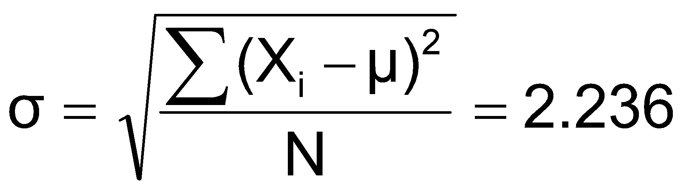
Developing a Sampling Distribution
(continued)
Summary Measures for the Population Distribution:
P(x)
.25
0
18 20 22 24
A B C D
x
Uniform Distribution

Slide 12
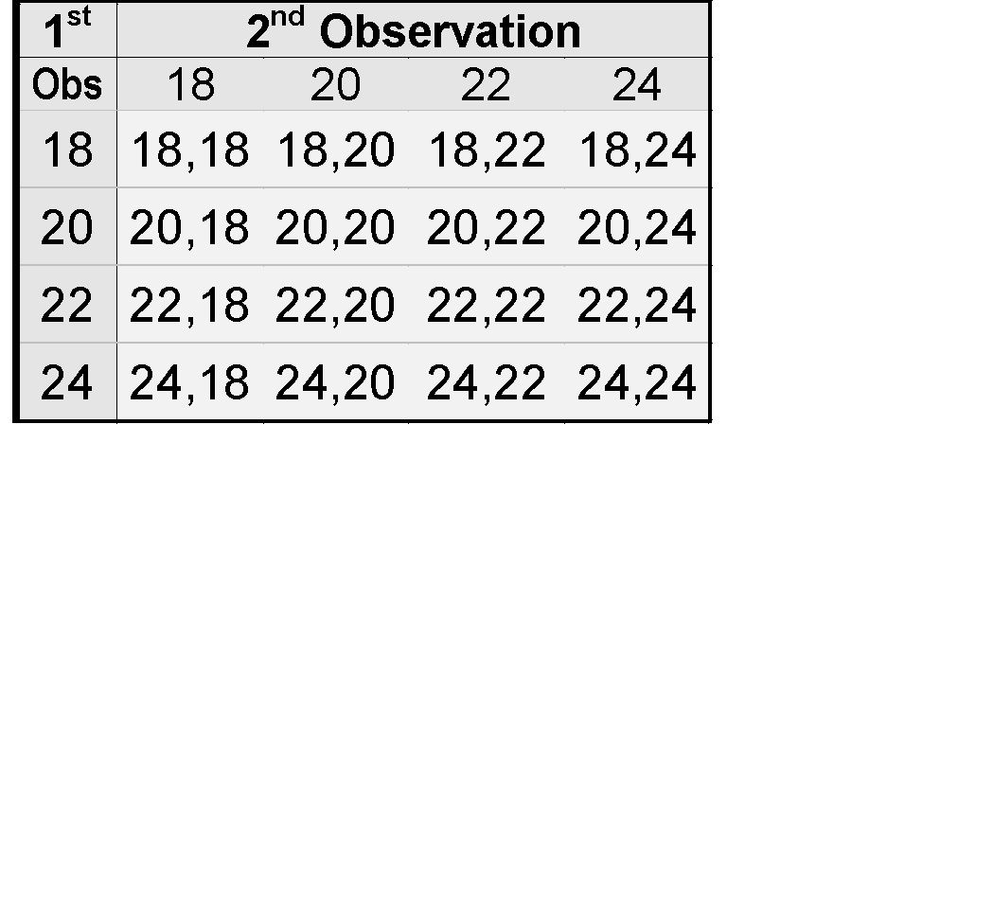
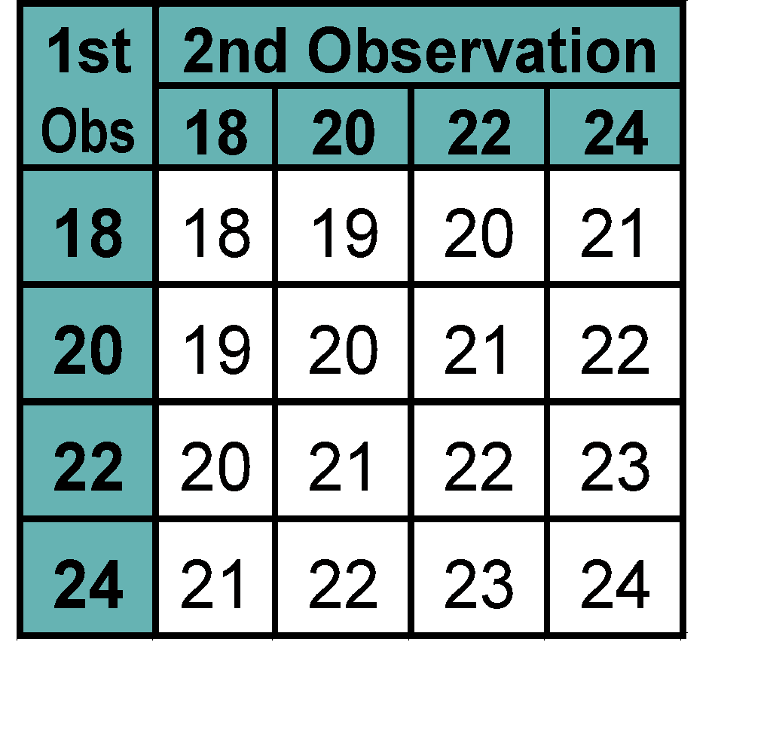
Now consider all possible samples of size n = 2
Developing a Sampling Distribution
(continued)
16 Sample Means
16 possible samples (sampling with replacement)

Slide 13

Sampling Distribution of All Sample Means
Developing a
Sampling Distribution
(continued)
16 Sample Means
Sample Means Distribution
_
P(X)
.3
.2
.1
0
_
18 19 20 21 22 23 24
X
(no longer uniform)

Slide 14
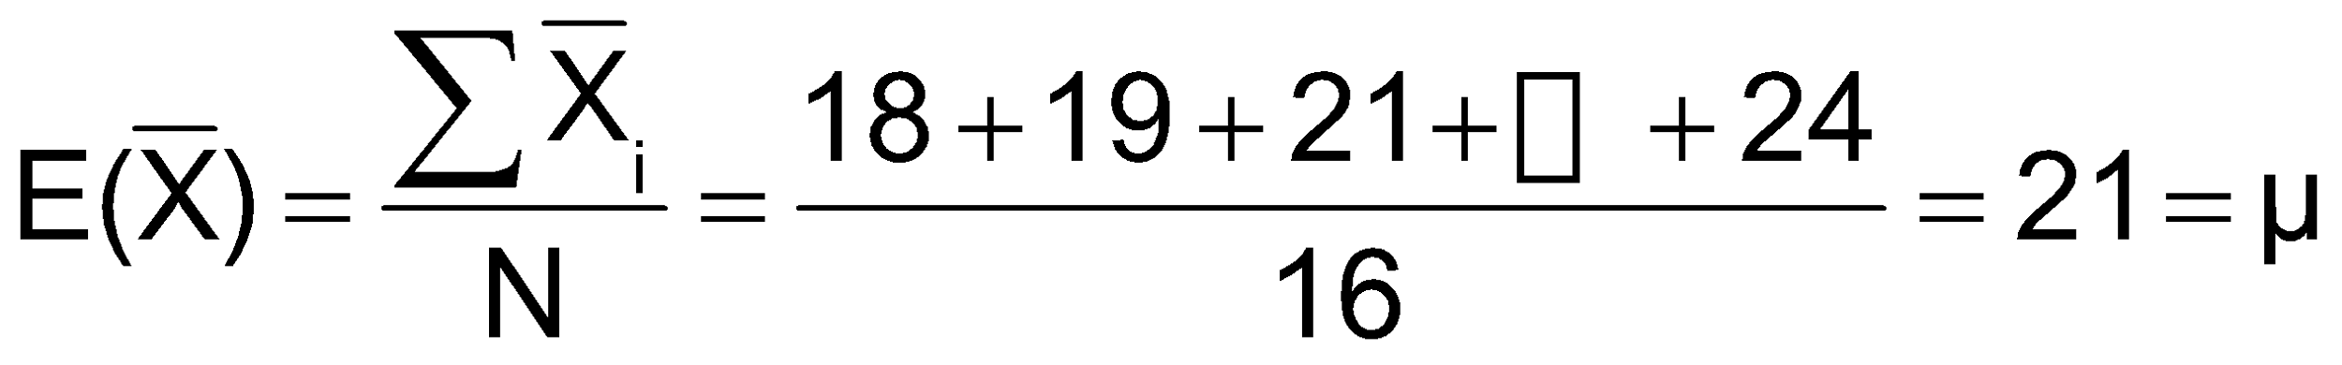
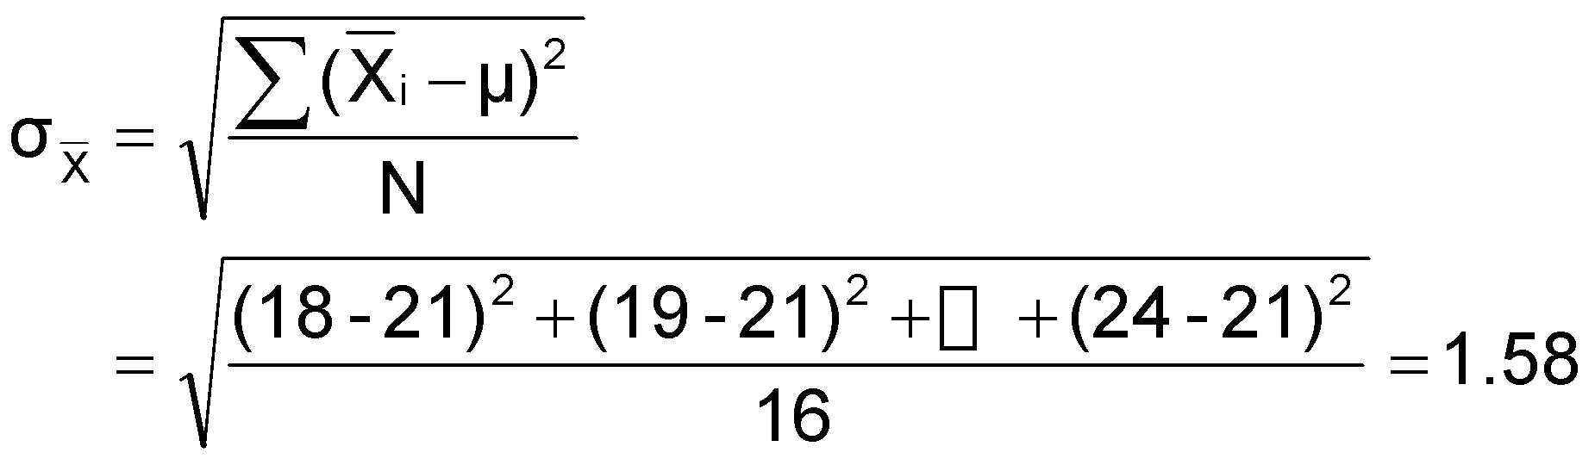
Summary Measures of this Sampling Distribution:
Developing a
Sampling Distribution
(continued)

Slide 15
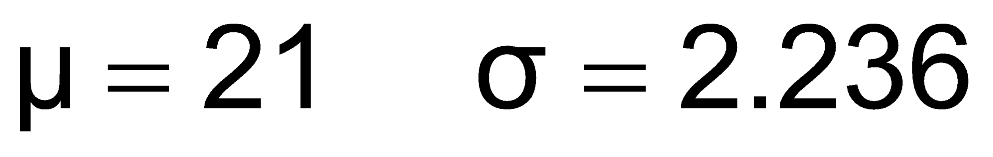
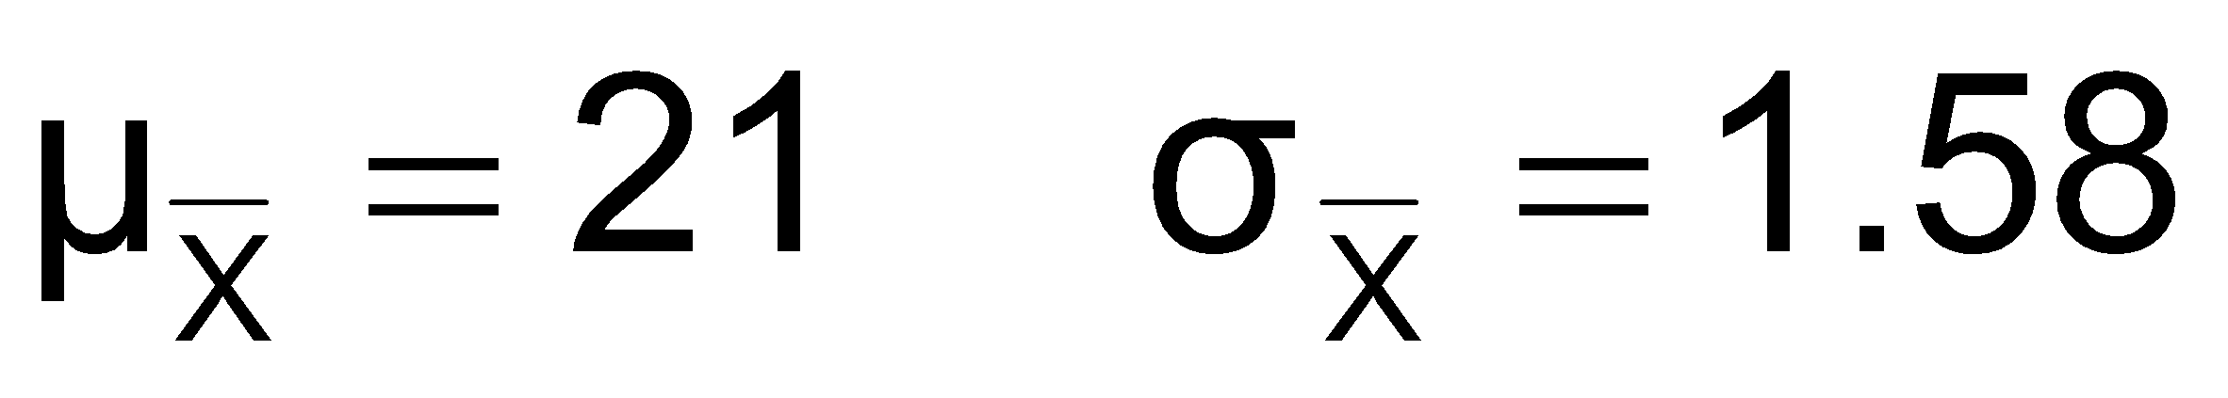
Comparing the Population with its Sampling Distribution
Population
N = 4
Sample Means Distribution
n = 2
_
P(X)
P(X)
.3
.3
.2
.2
.1
.1
0
0
_
18 20 22 24
A B C D
X
18 19 20 21 22 23 24
X

Slide 16
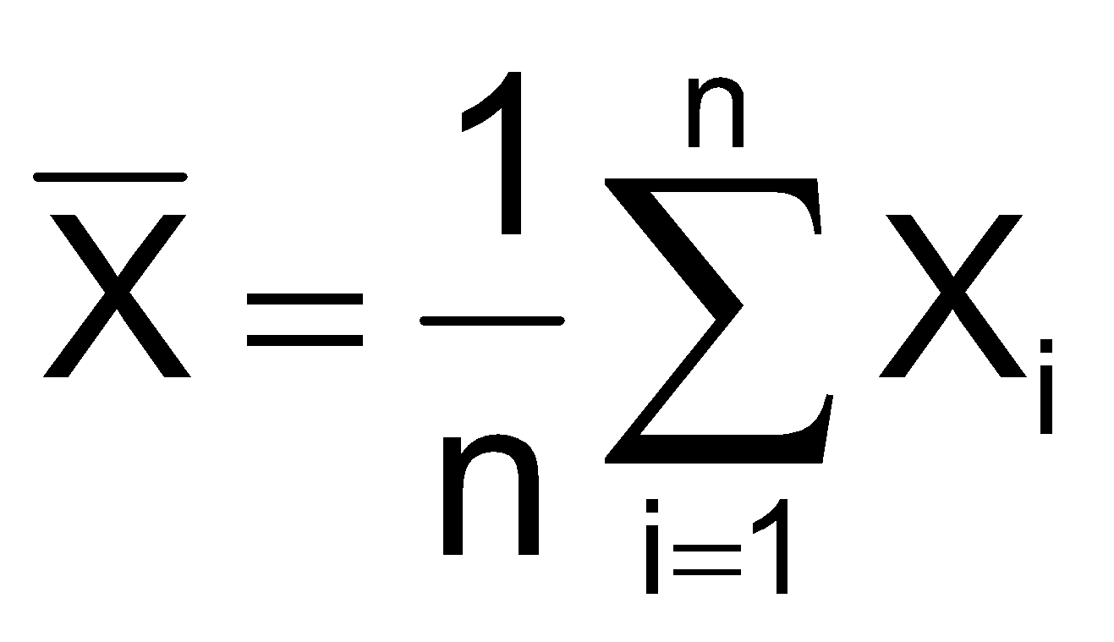
Expected Value of Sample Mean
Let X₁, X₂, . . . X_{n} represent a random sample from a population
The sample mean value of these observations is defined as

Slide 17
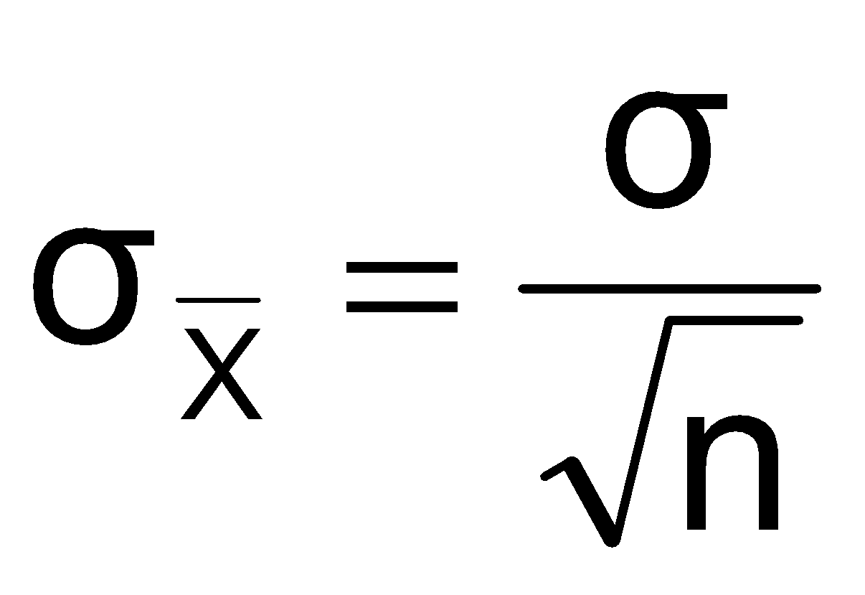
Standard Error of the Mean
Different samples of the same size from the same population will yield different sample means
A measure of the variability in the mean from sample to sample is given by the Standard Error of the Mean:
Note that the standard error of the mean decreases as the sample size increases

Slide 18

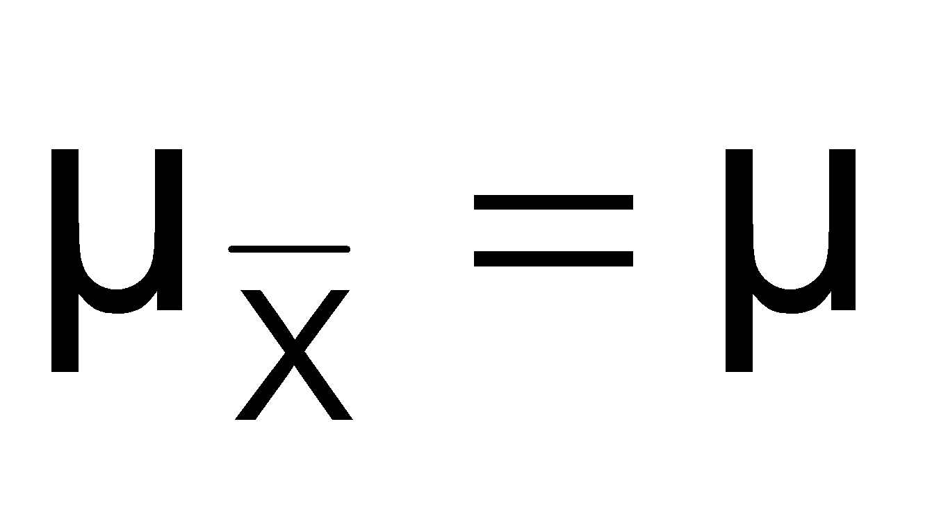
If the Population is Normal
If a population is normal with mean μ and standard deviation σ, the sampling distribution of is also normally distributed with
and

Slide 19

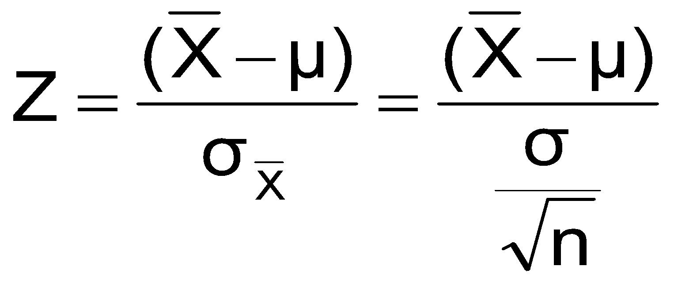




Z-value for Sampling Distribution of the Mean
Z-value for the sampling distribution of :
where: = sample mean
= population mean
= population standard deviation
n = sample size

Slide 20
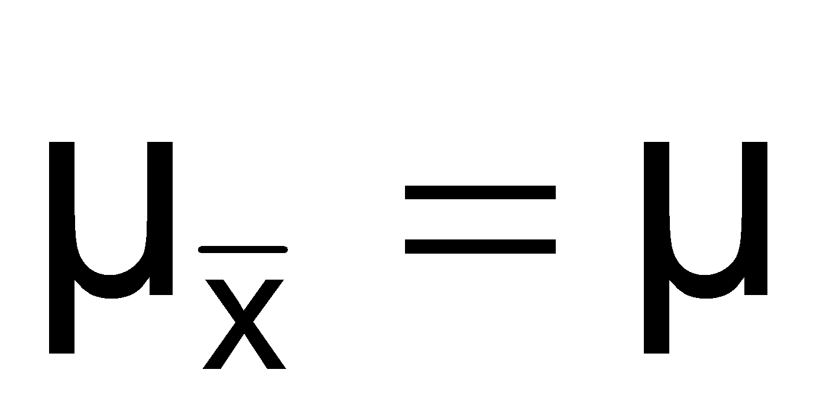



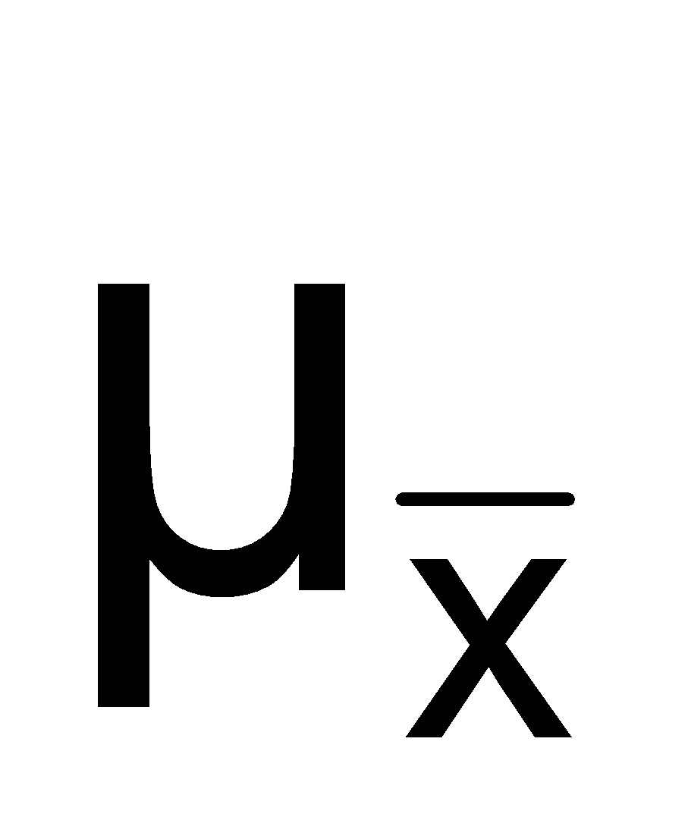
Sampling Distribution Properties
Normal Population Distribution
(i.e. is unbiased )
Normal Sampling Distribution
(has the same mean)

Slide 21
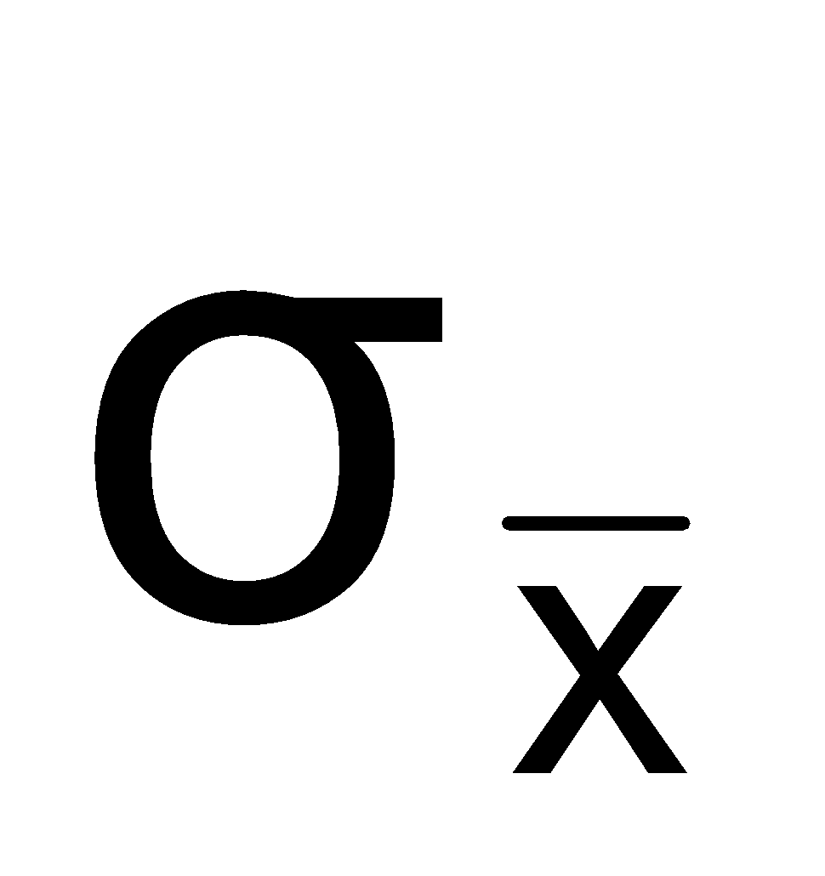


Sampling Distribution Properties
(continued)
For sampling with replacement:
As n increases,
decreases
Larger sample size
Smaller sample size

Slide 22

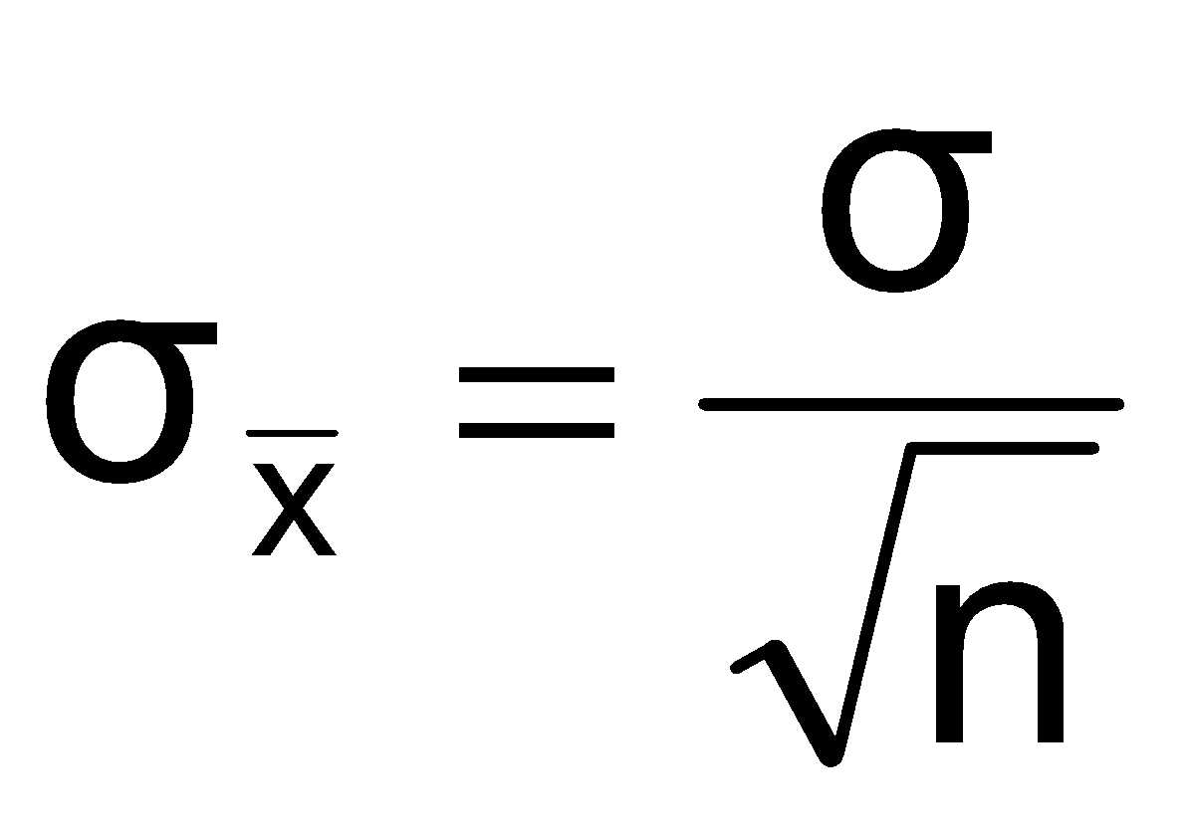
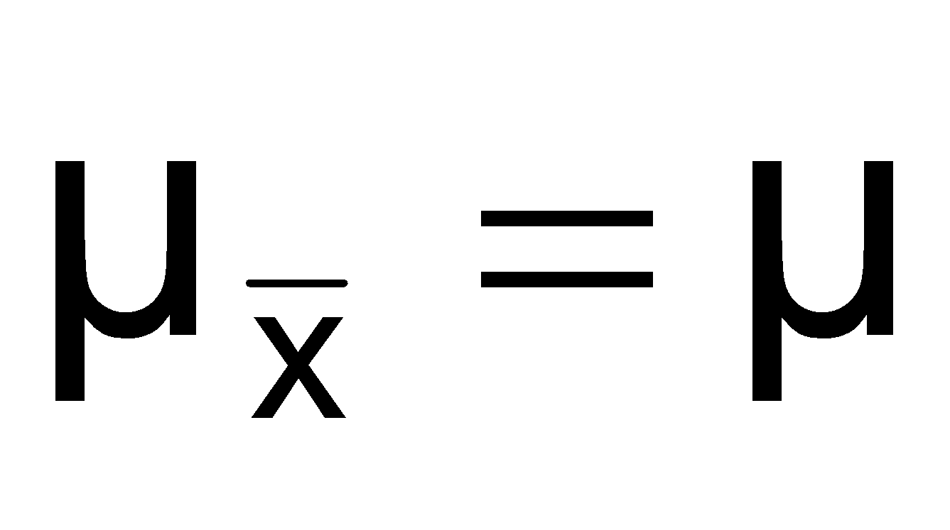
If the Population is not Normal
We can apply the Central Limit Theorem:
Even if the population is not normal,
…sample means from the population will be approximately normal as long as the sample size is large enough.
Properties of the sampling distribution:
and

Slide 23
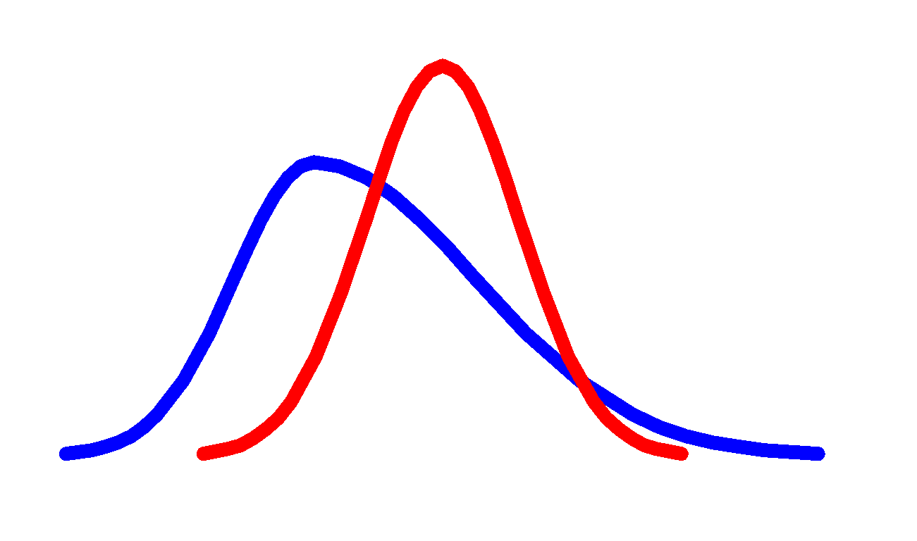
Central Limit Theorem
the sampling distribution becomes almost normal regardless of shape of population
As the sample size gets large enough…
n↑

Slide 24

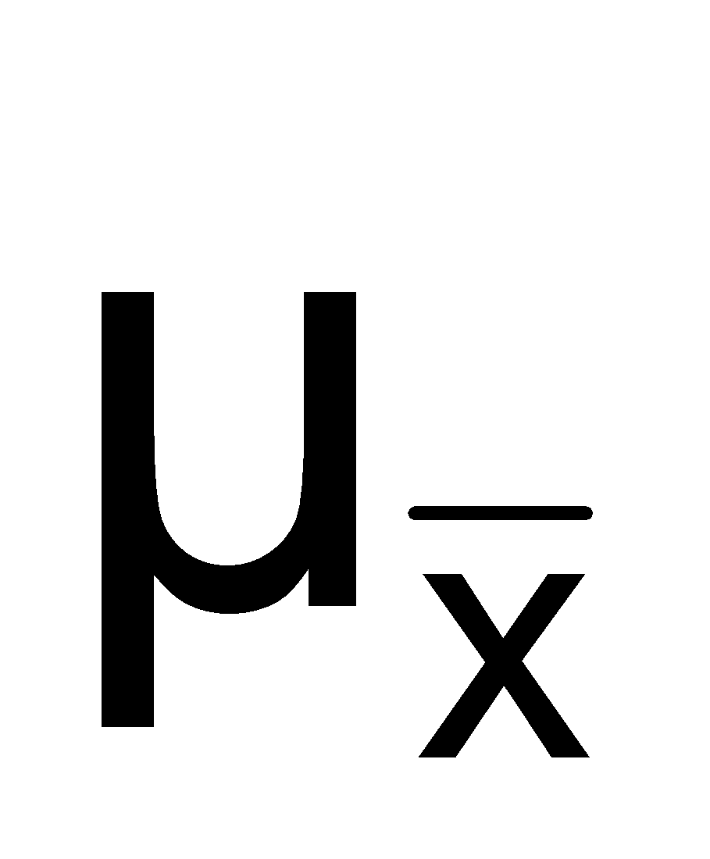
If the Population is not Normal
(continued)
Population Distribution
Sampling distribution properties:
Central Tendency
Variation
Sampling Distribution
(becomes normal as n increases)
Larger sample size
Smaller sample size

Slide 25
How Large is Large Enough?
For most distributions, n > 25 will give a sampling distribution that is nearly normal
For normal population distributions, the sampling distribution of the mean is always normally distributed

Slide 26
Example
Suppose a population has mean μ = 8 and standard deviation σ = 3. Suppose a random sample of size n = 36 is selected.
What is the probability that the sample mean is between 7.8 and 8.2?

Slide 27

Sampling Distributions of Sample Proportions
P = the proportion of the population having
some characteristic
Sample proportion ( ) provides an estimate
of P:
0 ≤ ≤ 1
has a binomial distribution, but can be approximated by a normal distribution when nP(1 – P) > 9

Slide 28
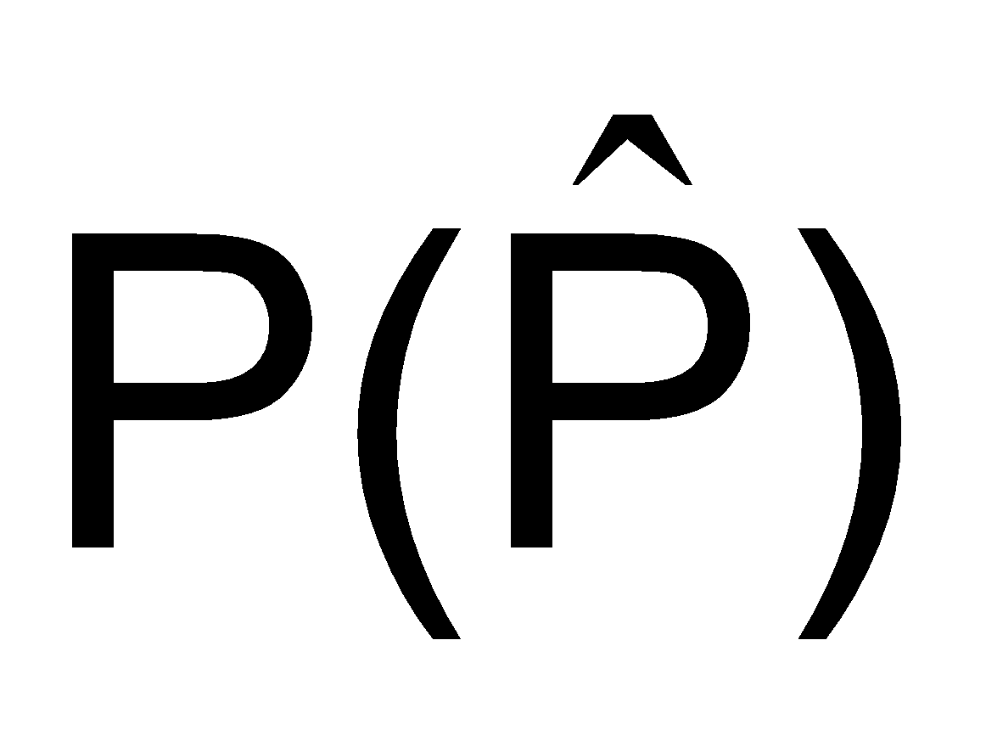

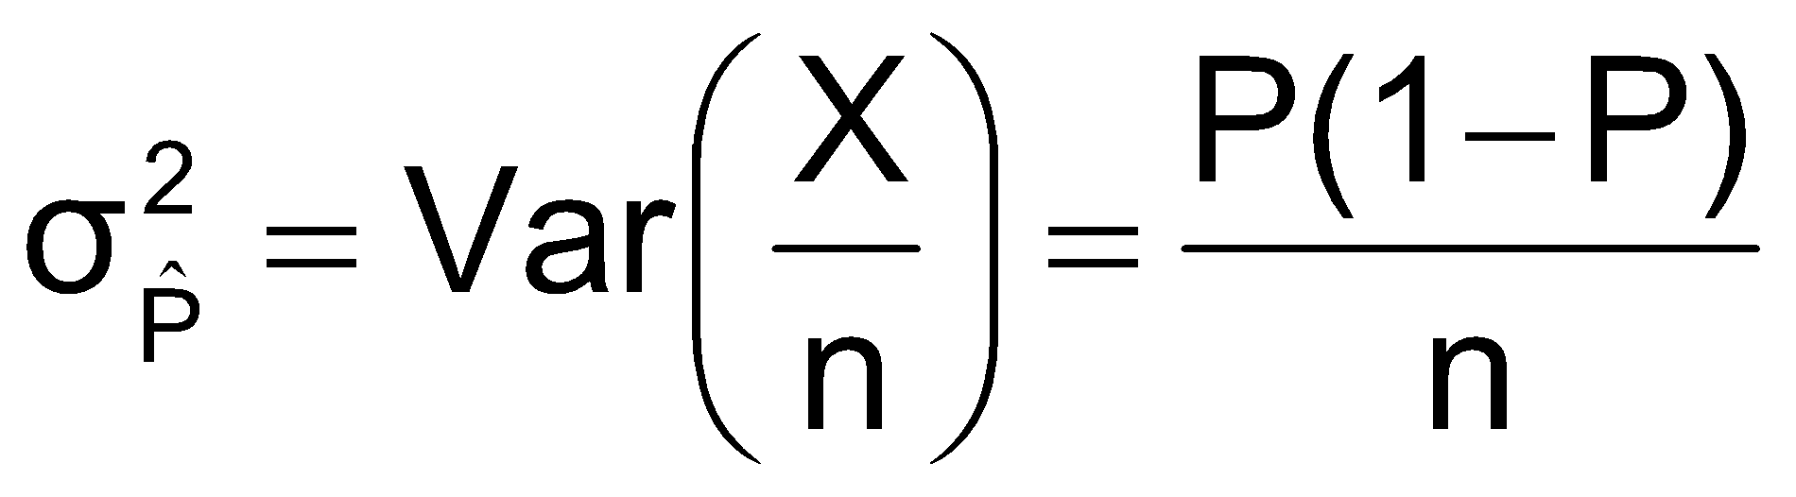
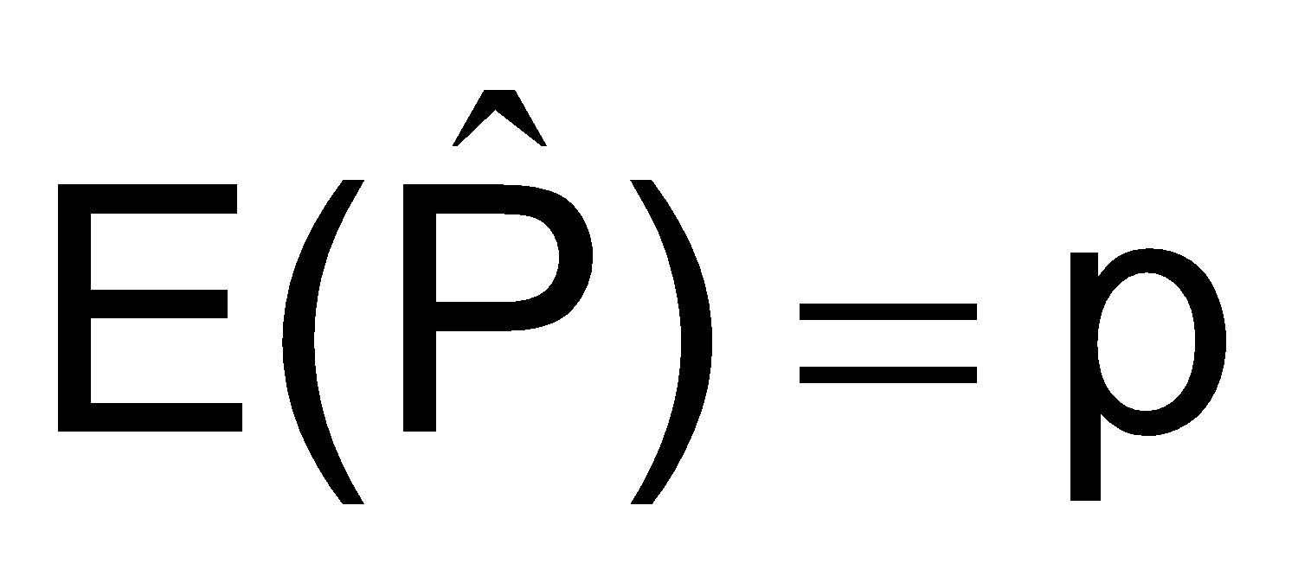
Sampling Distribution of P
^
Normal approximation:
Properties:
and
Sampling Distribution
.3
.2
.1
0
0 . 2 .4 .6 8 1
(where P = population proportion)

Slide 29

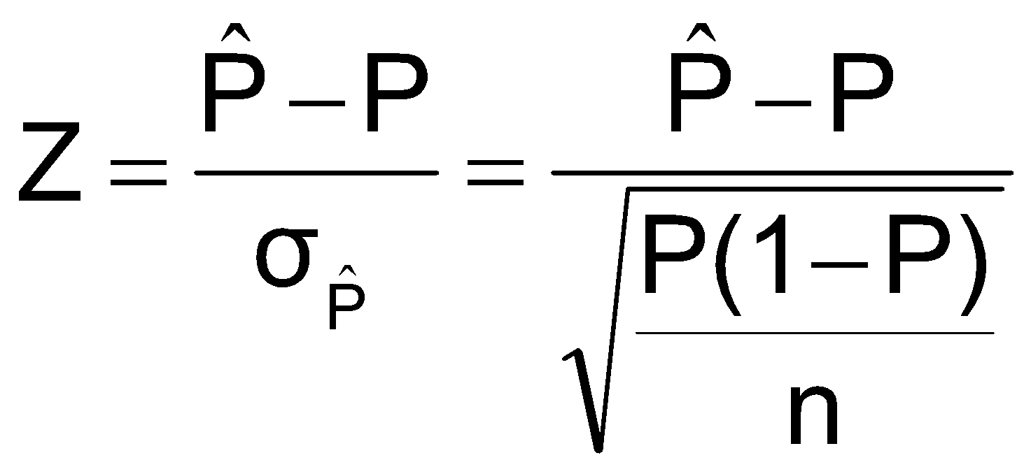
Z-Value for Proportions
Standardize to a Z value with the formula:

Slide 30
Example
If the true proportion of voters who support Proposition A is P = .4, what is the probability that a sample of size 200 yields a sample proportion between .40 and .45?

Slide 31
Point estimate and confidence interval estimate

Slide 32
Definitions
An estimator of a population parameter is
a random variable that depends on sample information . . .
whose value provides an approximation to this unknown parameter
A specific value of that random variable is called an estimate

Slide 33
Point and Interval Estimates
A point estimate is a single number,
a confidence interval provides additional information about variability
Lower
Confidence
Limit
Upper
Confidence
Limit
Point Estimate
Width of
confidence interval

Slide 34

Point Estimates
We can estimate a
Population Parameter …
with a Sample Statistic
(a Point Estimate)
Mean
μ
x
Proportion
P

Slide 35
Confidence Intervals
How much uncertainty is associated with a point estimate of a population parameter?
An interval estimate provides more information about a population characteristic than does a point estimate
Such interval estimates are called confidence intervals

Slide 36
Confidence Interval Estimate
An interval gives a range of values:
Takes into consideration variation in sample statistics from sample to sample
Based on observation from 1 sample
Gives information about closeness to unknown population parameters
Stated in terms of level of confidence
Can never be 100% confident

Slide 37
Confidence Interval and Confidence Level
If P(a < θ < b) = 1 - α then the interval from a to b is called a 100(1 - α)% confidence interval of θ.
The quantity (1 - α) is called the confidence level of the interval (α between 0 and 1)
In repeated samples of the population, the true value of the parameter θ would be contained in 100(1 - α)% of intervals calculated this way.
The confidence interval calculated in this manner is written as a < θ < b with 100(1 - α)% confidence

Slide 38
Estimation Process
Random Sample
I am 95% confident that μ is between 40 & 60.
Population
Mean
X = 50
(mean, μ, is unknown)
Sample

Slide 39
Confidence Level, (1-α)
(continued)
Suppose confidence level = 95%
Also written (1 - α) = 0.95
A relative frequency interpretation:
From repeated samples, 95% of all the confidence intervals that can be constructed will contain the unknown true parameter
A specific interval either will contain or will not contain the true parameter
No probability involved in a specific interval

Slide 40
General Formula
The general formula for all confidence intervals is:
The value of the reliability factor depends on the desired level of confidence
Point Estimate ± (Reliability Factor)(Standard Error)

Slide 41
Confidence Intervals
Confidence
Intervals
Population
Mean
Population
Proportion
σ² Known
σ² Unknown

Slide 42

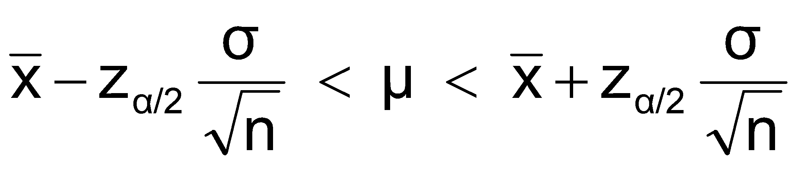
Confidence Interval for μ (σ² Known)
Assumptions
Population variance σ² is known
Population is normally distributed
If population is not normal, use large sample
Confidence interval estimate:
(where z_{α/2} is the normal distribution value for a probability of α/2 in each tail)

Slide 43
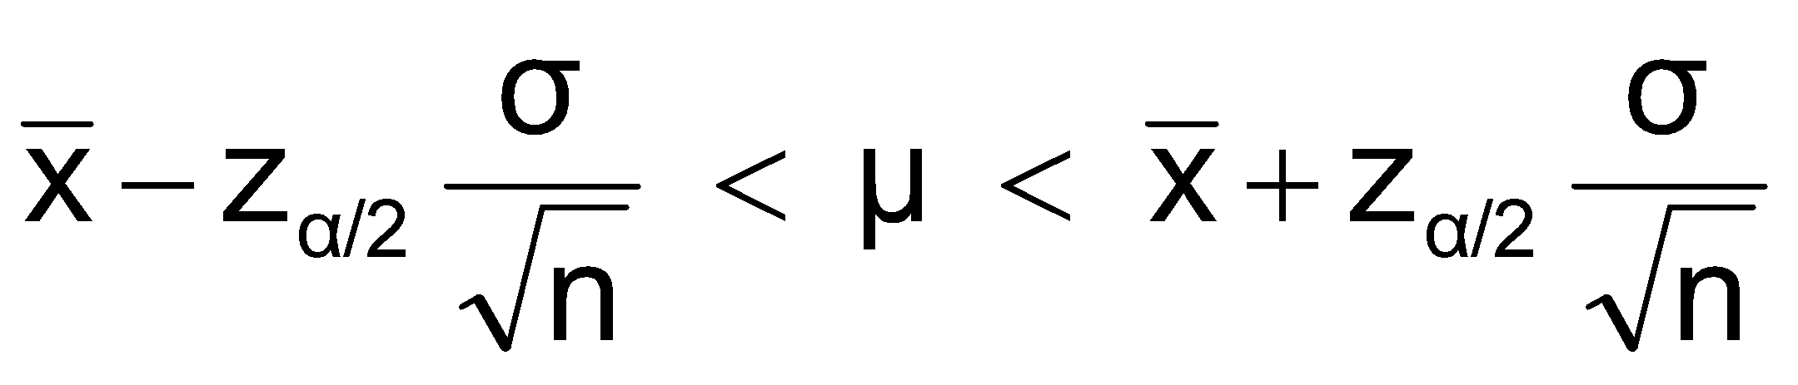
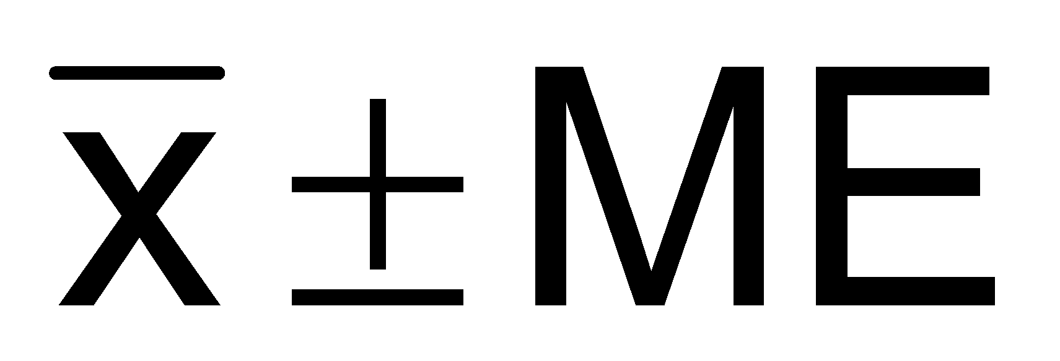
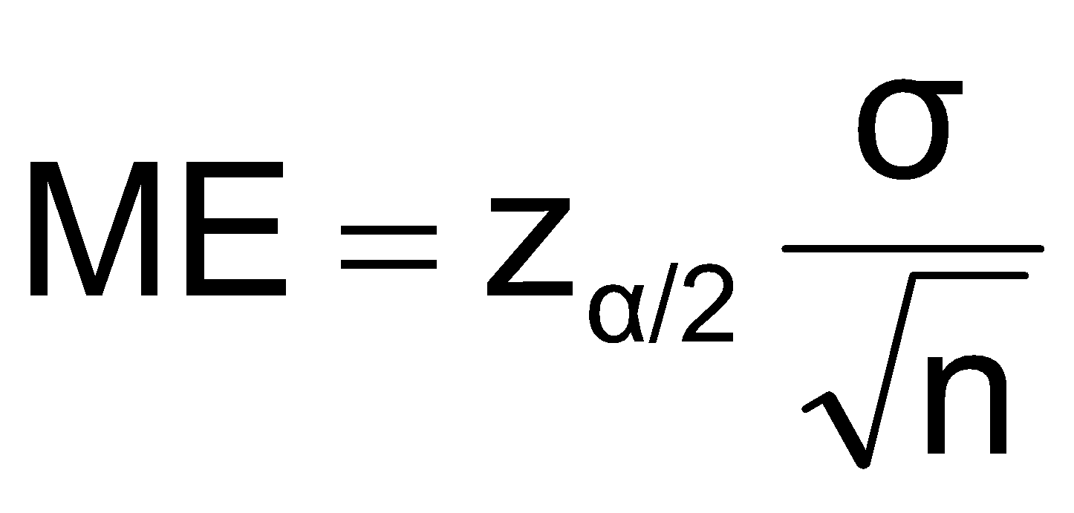
Margin of Error
The confidence interval,
Can also be written as
where ME is called the margin of error
The interval width, w, is equal to twice the margin of error

Slide 44
Reducing the Margin of Error
The margin of error can be reduced if
the population standard deviation can be reduced (σ↓)
The sample size is increased (n↑)
The confidence level is decreased, (1 – α) ↓

Slide 45
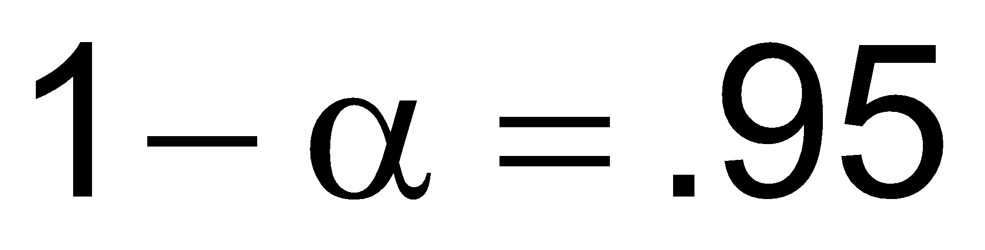
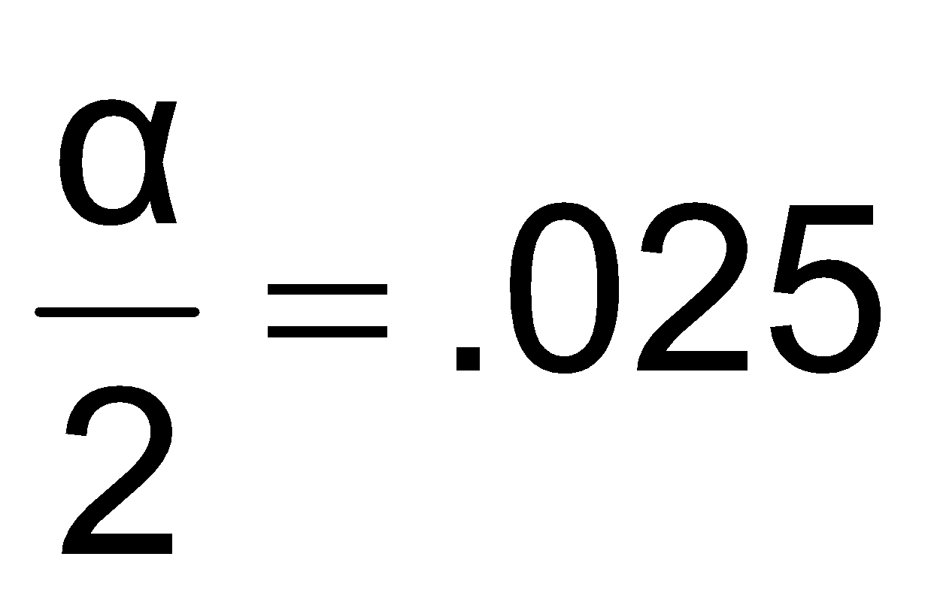
Finding the Reliability Factor, z_{α/2}
Consider a 95% confidence interval:
Z units:
z = -1.96
0
z = 1.96
X units:
Lower
Confidence
Limit
Upper
Confidence
Limit
Point Estimate
Point Estimate
Find z_{.025} = ±1.96 from the standard normal distribution table

Slide 46
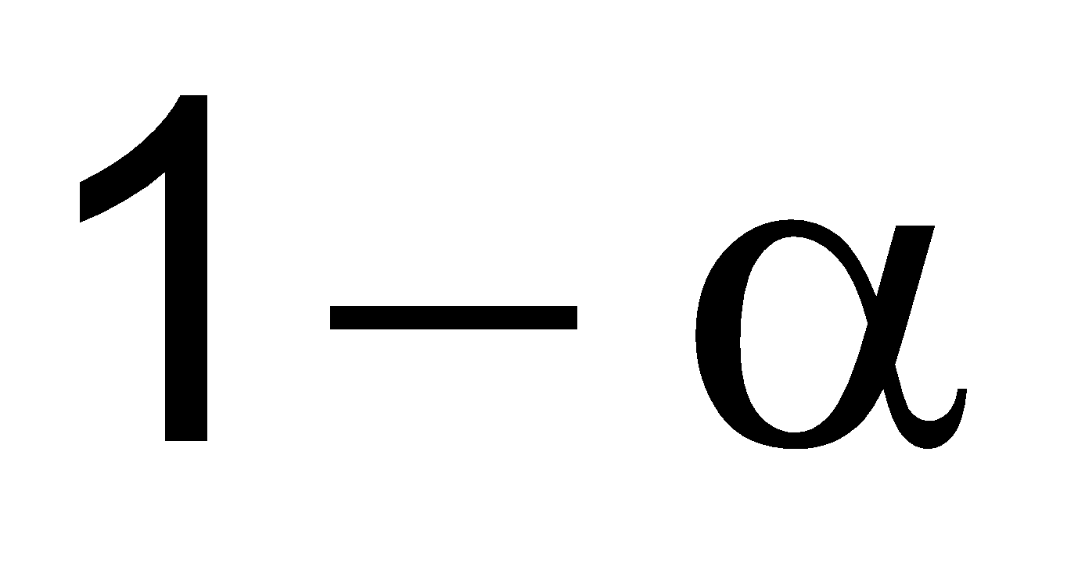
Common Levels of Confidence
Commonly used confidence levels are 90%, 95%, and 99%
Confidence Coefficient,
Confidence Level
Z_{α/2} value
80%
90%
95%
98%
99%
99.8%
99.9%
.80
.90
.95
.98
.99
.998
.999
1.28
1.645
1.96
2.33
2.58
3.08
3.27

Slide 47
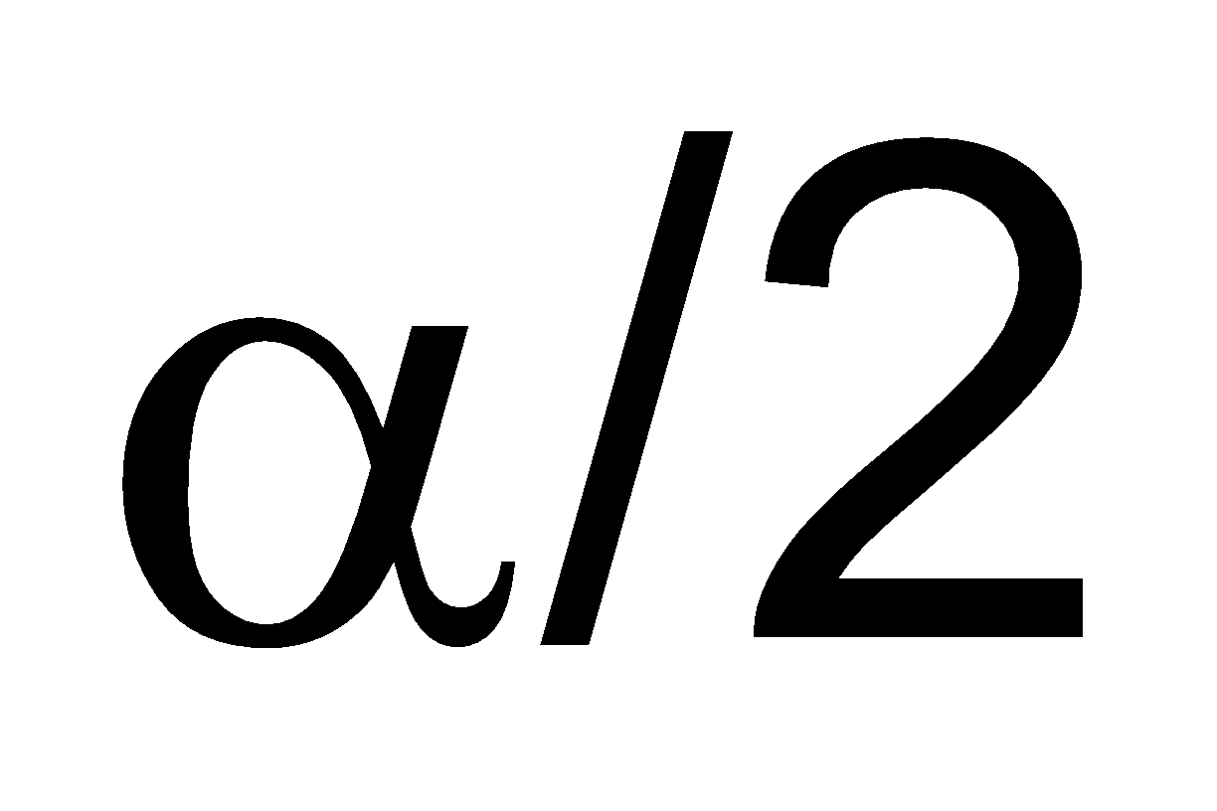
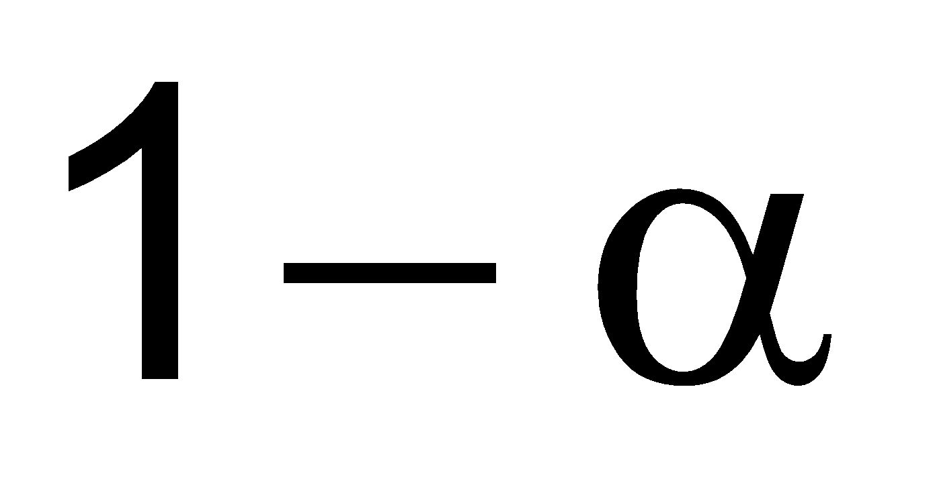
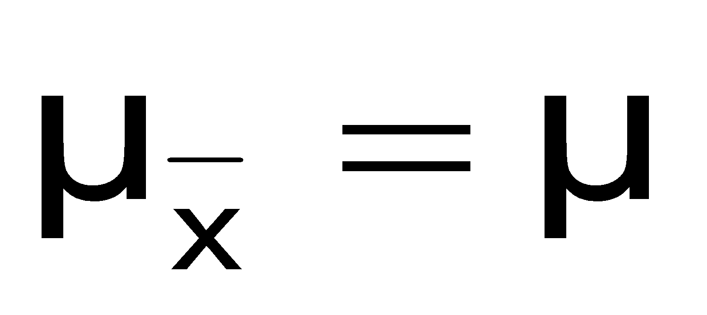
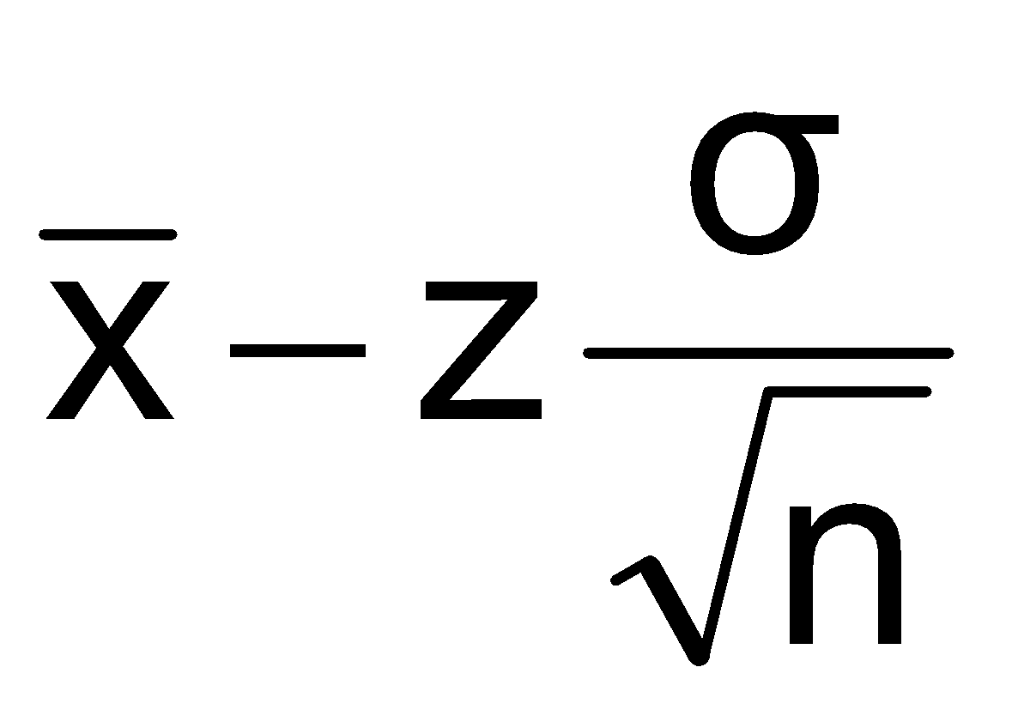
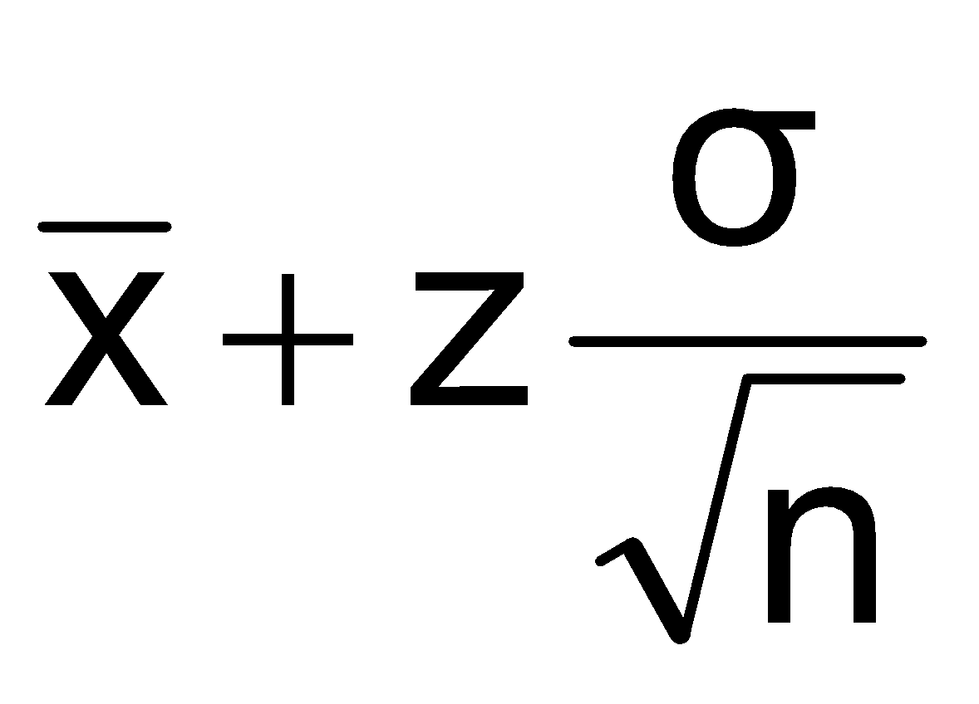
Intervals and Level of Confidence
Sampling Distribution of the Mean
x
Intervals extend from
to
x₁
x₂
100(1-α)% of intervals constructed contain μ;
100(α)% do not.
Confidence Intervals

Slide 48

Example
A sample of 11 circuits from a large normal population has a mean resistance of 2.20 ohms. We know from past testing that the population standard deviation is 0.35 ohms.
Determine a 95% confidence interval for the true mean resistance of the population.

Slide 49
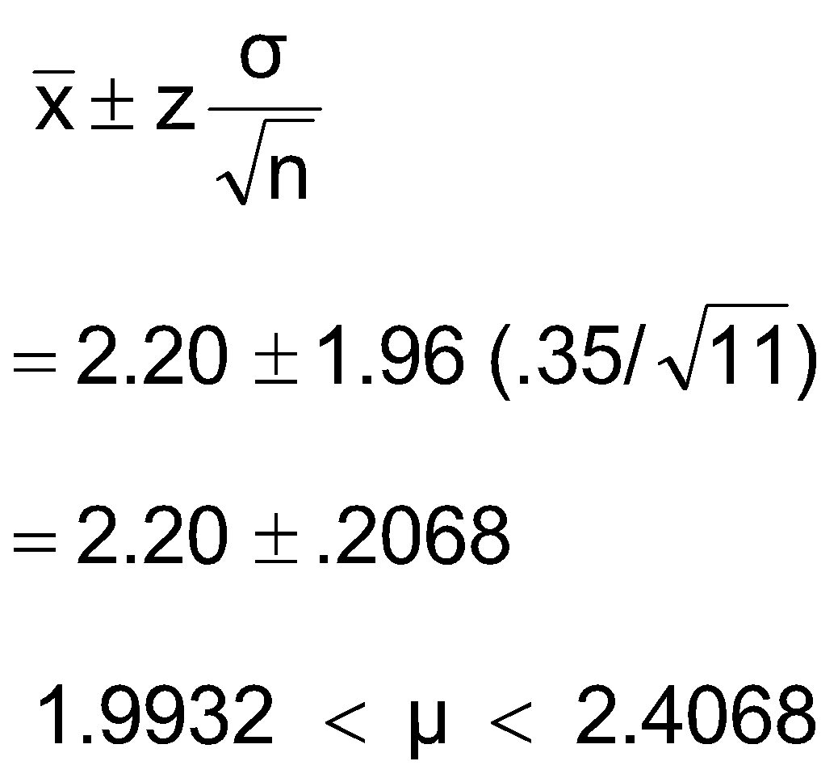

Example
(continued)
A sample of 11 circuits from a large normal population has a mean resistance of 2.20 ohms. We know from past testing that the population standard deviation is .35 ohms.
Solution:

Slide 50
Interpretation
We are 95% confident that the true mean resistance is between 1.9932 and 2.4068 ohms
Although the true mean may or may not be in this interval, 95% of intervals formed in this manner will contain the true mean

Slide 51
Confidence Intervals
Confidence
Intervals
Population
Mean
Population
Proportion
σ² Known
σ² Unknown

Slide 52
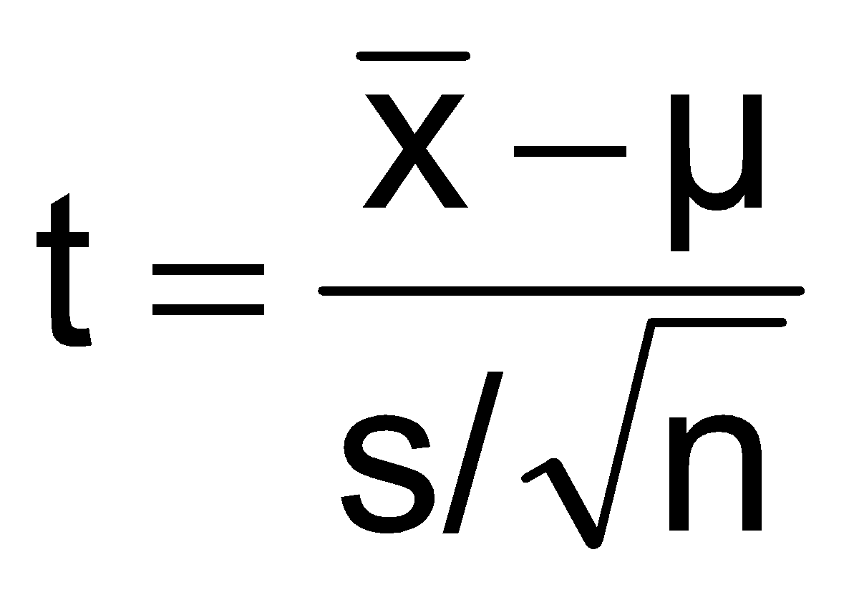
Student’s t Distribution
Consider a random sample of n observations
with mean x and standard deviation s
from a normally distributed population with mean μ
Then the variable
follows the Student’s t distribution with (n - 1) degrees of freedom

Slide 53
Confidence Interval for μ (σ² Unknown)
If the population standard deviation σ is unknown, we can substitute the sample standard deviation, s
This introduces extra uncertainty, since s is variable from sample to sample
So we use the t distribution instead of the normal distribution

Slide 54
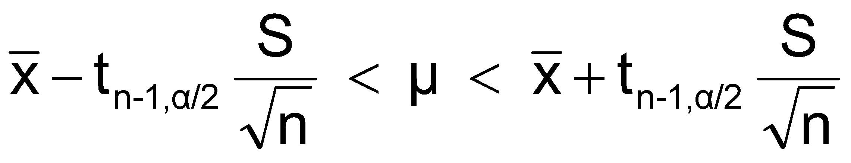
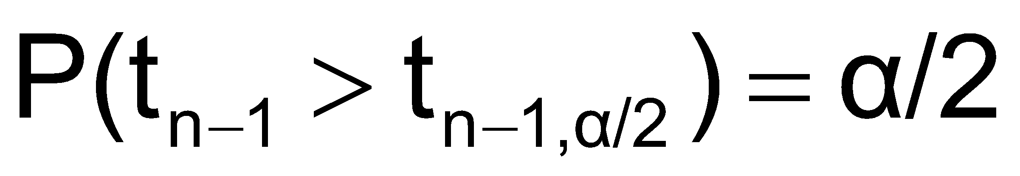
Confidence Interval for μ (σ Unknown)
(continued)
Assumptions
Population standard deviation is unknown
Population is normally distributed
If population is not normal, use large sample
Use Student’s t Distribution
Confidence Interval Estimate:
where t_{n-1,α/2} is the critical value of the t distribution with n-1 d.f. and an area of α/2 in each tail:

Slide 55
Student’s t Distribution
The t is a family of distributions
The t value depends on degrees of freedom (d.f.)
Number of observations that are free to vary after sample mean has been calculated
d.f. = n - 1

Slide 56
Student’s t Distribution
Note: t Z as n increases
Standard Normal
(t with df = ∞)
t (df = 13)
t-distributions are bell-shaped and symmetric, but have ‘fatter’ tails than the normal
t (df = 5)
t
0

Slide 57
Student’s t Table
Upper Tail Area
Let: n = 3 df = n - 1 = 2 α = .10 α/2 =.05
df
.10
.05
.025
1
3.078
6.314
12.706
2
1.886
2.920
4.303
3
1.638
2.353
3.182
α/2 = .05
The body of the table contains t values, not probabilities
0
2.920
t

Slide 58
Confidence Intervals
Confidence
Intervals
Population
Mean
Population
Proportion
σ Known
σ Unknown

Slide 59

Confidence Intervals for the Population Proportion, p
An interval estimate for the population proportion ( P ) can be calculated by adding an allowance for uncertainty to the sample proportion ( )

Slide 60
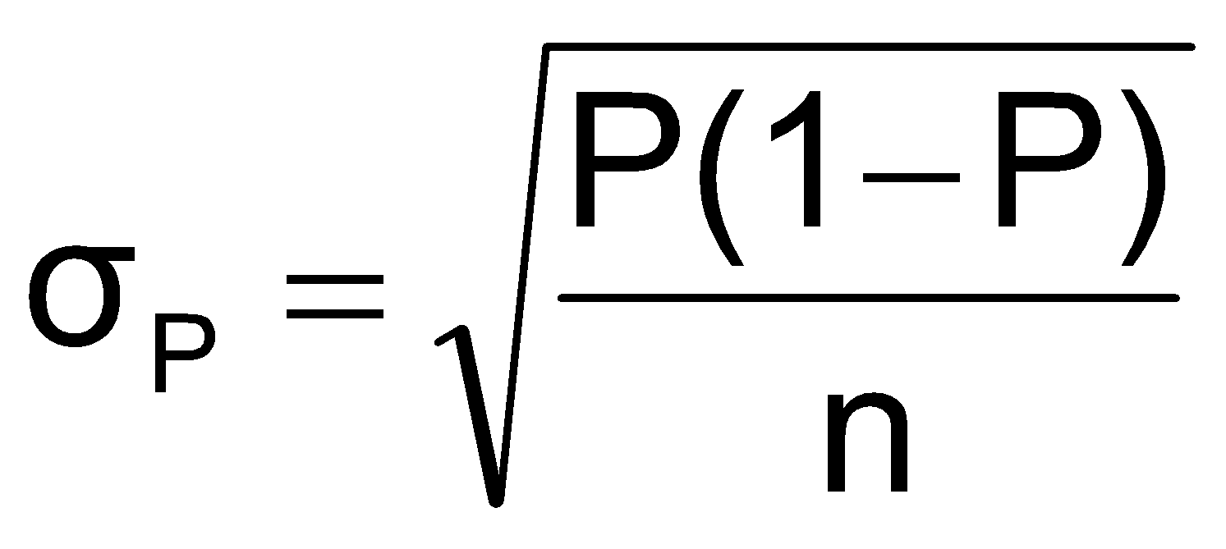
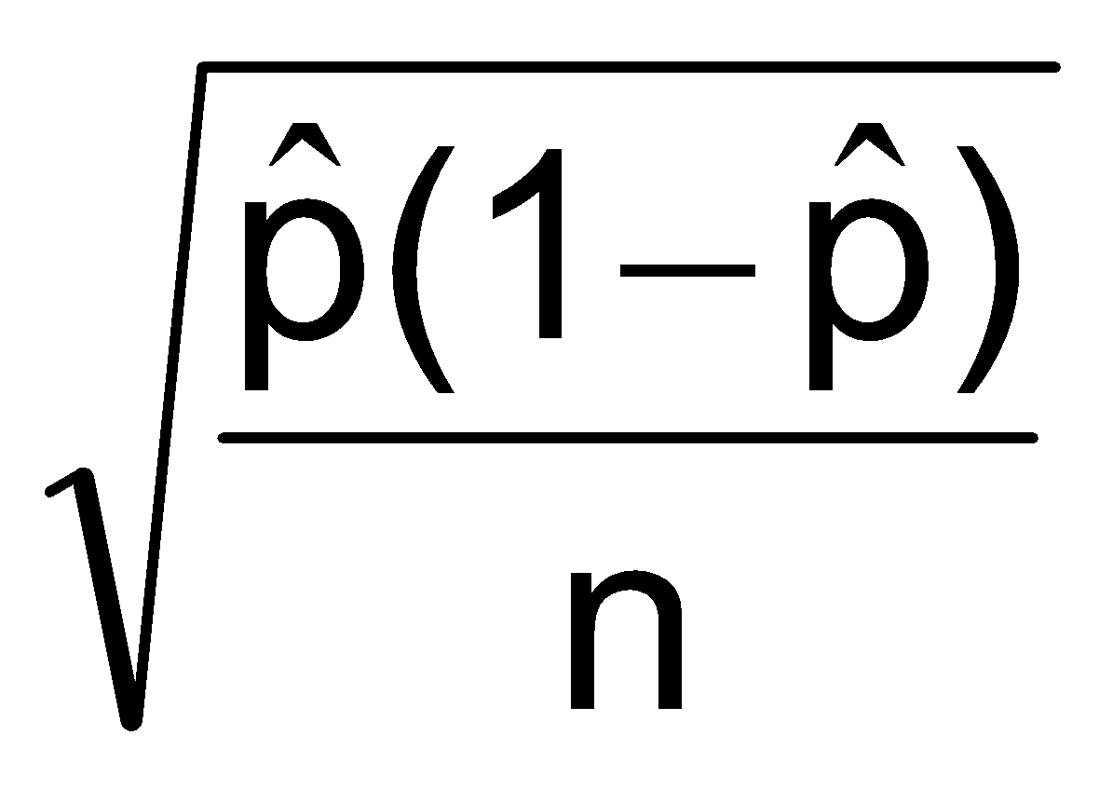
Confidence Intervals for the Population Proportion, p
(continued)
Recall that the distribution of the sample proportion is approximately normal if the sample size is large, with standard deviation
We will estimate this with sample data:

Slide 61
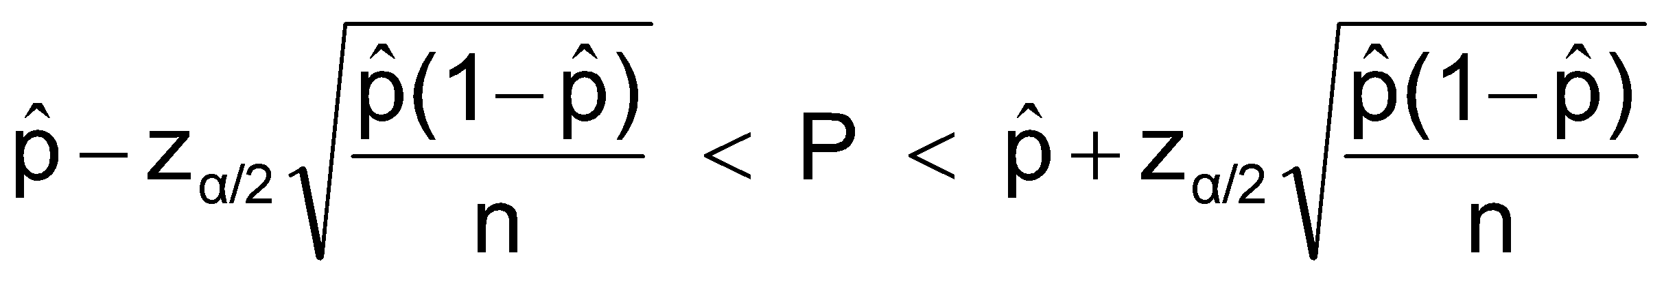

Confidence Interval Endpoints
Upper and lower confidence limits for the population proportion are calculated with the formula
where
z_{α/2} is the standard normal value for the level of confidence desired
is the sample proportion
n is the sample size

Slide 62

Example
A random sample of 100 people shows that 25 are left-handed.
Form a 95% confidence interval for the true proportion of left-handers

